Slide 1
Event Handling in Java
Delegation Event Model :
A source generates an event and sends it to one or more
listeners
The listener simply waits until it receives an event
Once an event is received, the listener processes the
event and then returns
The event generating component delegates the
responsibility of performing an event-based action to a
separate event-performing component

Slide 2
Event Handling in Java
Events :
It is an object that describes a state change in a source
Event could be the occurrence of any activity such as
mouse click or key press
An event may be generated when a timer expires, s/w or h/w failure occurs or an operation is completed

Slide 3
Event Handling in Java
Event Sources :
A source is an object that generates an event. It occurs
when the internal state of that object changes. Sources
may generate more than one type of event
A source must register listeners in order for the listeners to receive notifications about a specific type of event
public void addTypeListener (TypeListener el)
where, Type is the event name and el is the reference to
the event listener
Ex:
addKeyListener()
addMouseMotionListener()

Slide 4
Event Handling in Java
Event Sources :
Some sources may allow only one listener to register
public void addTypeListener(TypeListener el) throws
java.util.TooManyListenersException
A source must provide mechanism to unregister listener
public void removeTypeListener(TypeListener el)
Ex: removeKeyListener()

Slide 5
Event Handling in Java
Event Listeners :
A Listener is an object which is notified when an event occurs
i. It must have been registered with one/more sources to
receive notifications
ii. It must implement methods to receive and process
these notifications
The methods that receive and process events are
implemented from the corresponding listener interfaces in
java.awt.event package

Slide 6
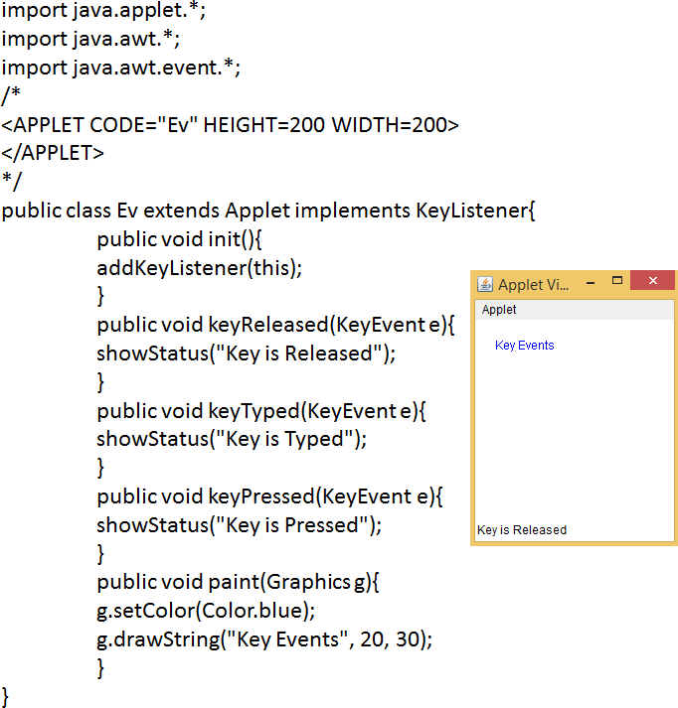
Event Handling in Java
Example :

Slide 7
Event Handling in Java
Event Classes :
All the events have corresponding event classes associated with them. Each class is derived from the super class EventObject in java.util package
EventObject(Object src)
where, src is the object that generates this event
EventObject contains two methods:
i. getSource(): returns the source of the event
ii. toString(): returns the string equivalent of the event
The immediate subclass of EventObject is the AWTEvent class from which all the AWT-based event classes are derived
i. getID(): used to determine the event type

Slide 8
Event Handling in Java
Commonly Used Event Classes :
ActionEvent: button pressed, menu item selected, list item double-clicked
ItemEvent: check box or list item clicked, choice selection
made, checkable menu item selected
KeyEvent: input receieved from keyboard
MouseEvent: mouse dragged, moved, clicked, pressed or
released
TextEvent: value of text area or text field changed

Slide 9
Event Handling in Java
Commonly Used Event Classes :
Button : generates action events when the button is
pressed
Check Box: generates item events when the check box is
selected/deselected
Choice: generates item events when the choice is changed
List: generates action events when an item is
double-clicked. It also generates item events when an item
is selected/deselected

Slide 10
Event Handling in Java
Commonly Used Event Classes :
Menu Item: generates action events when a menu item is
selected. It also generates item events when a checkable
menu item is selected/deselected
Text Components: generates text events when the user
enters a character

Slide 11
Event Handling in Java
Event Listener Interfaces :
Event Listeners are created by implementing one or more
interfaces defined by java.awt.event package
ActionListener: defines a method to receive action
events. actionPerformed()
ItemListener: defines a method to recognize when the
state of an item changes. itemStateChanged()
KeyListener: defines methods to recognize when a key is
pressed, released or typed. keyPressed(), keyReleased(), keyTyped()

Slide 12
Event Handling in Java
Event Listener Interfaces :
MouseListener: defines methods to recognize when the
mouse is clicked, enters a component, exits a component,
is pressed or is released. mouseClicked(), mouseExited(),
mouseEntered(), mousePressed(), mouseReleased()
MouseMotionListener: defines methods to recognize
when the mouse is dragged or moved. mouseDragged(),
mouseMoved()
TextListener: defines a method to recognize when a text
value changes. textChanged()

Slide 13
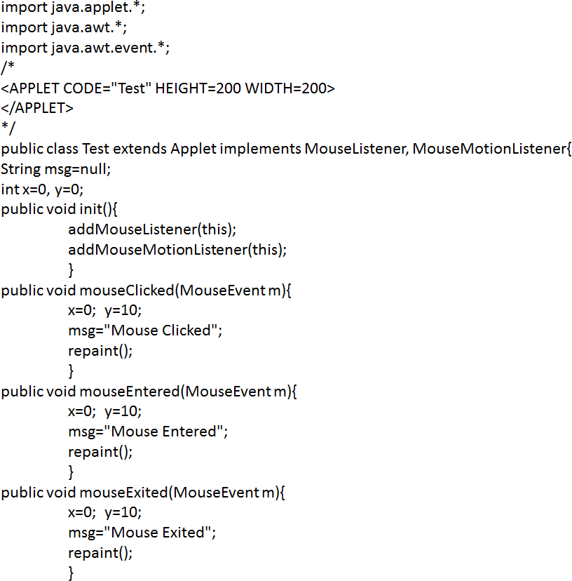
Event Handling in Java
Event Listener Interfaces Example:

Slide 14
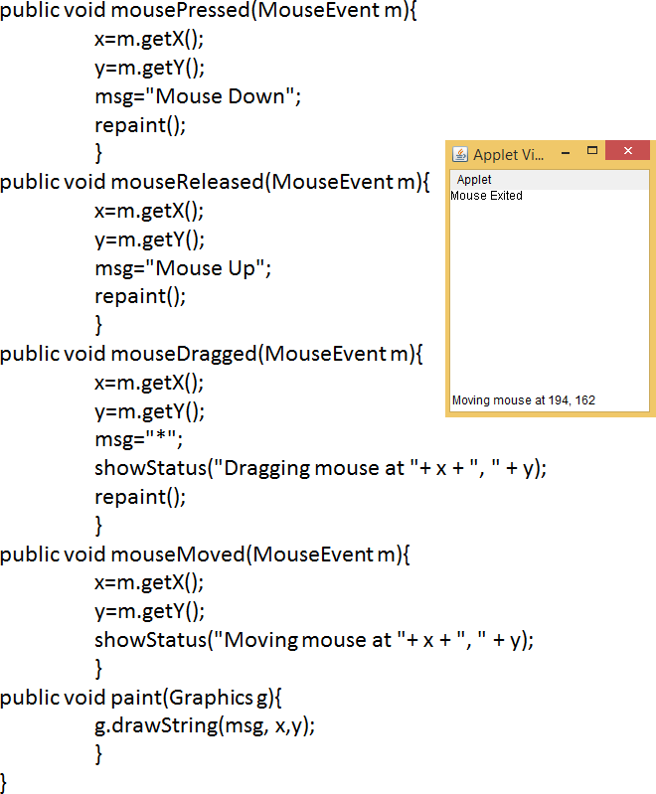
Event Handling in Java
Event Listener Interfaces Example:

Slide 15
Event Handling in Java
Event Handling using Adapter Class :
Adapter class can simplify the creation of event handlers
An adapter class provides an empty implementation of all
methods in an event listener interface
For listener interfaces containing more than one event
handling methods, JDK defines corresponding adapter
classes
Ex: MouseMotionAdapter class has two methods,
mouseDragged() and mouseMoved()

Slide 16
Event Handling in Java
Event Handling using Adapter Class :
As the adapter classes have already provided definitions
with empty bodies, you don’t have to provide implementations for all the methods again; i.e. we only need to override our methods of interest
Commonly used adapter classes: KeyAdapter,MouseAdapter, MouseMotionAdapter

Slide 17
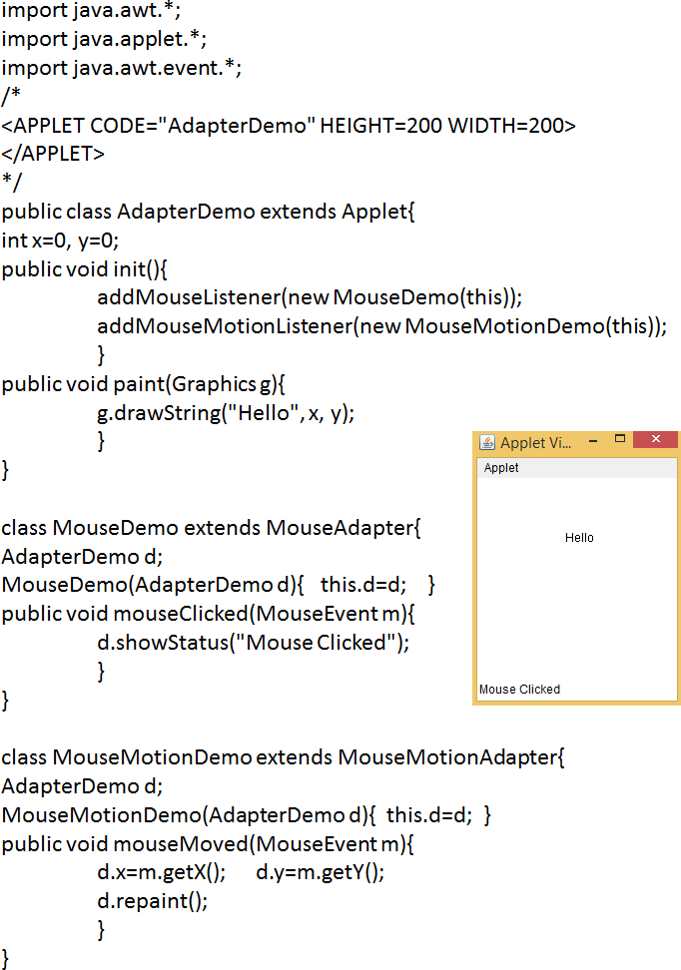
Event Handling in Java
Event Handling using Adapter Class :

Slide 18
Event Handling in Java
Event Handling using Inner Classes :
Inner class is a class defined within another class or even
within an expression

Slide 19
Event Handling in Java
Event Handling using Inner Classes :

Slide 20
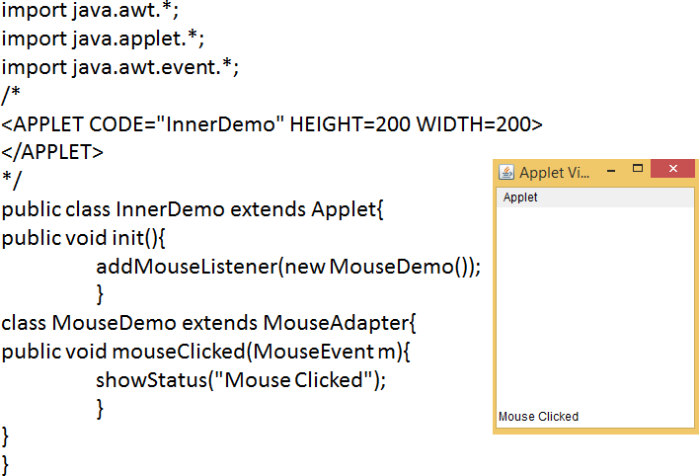
Event Handling in Java
Event Handling using Inner Classes :

Slide 21
Event Handling in Java
Event Handling using Anonymous Inner Classes :
An anonymous inner class is one that is not assigned a
name
new MouseAdapter()... indicates to the compiler that the
code between the braces defines an anonymous inner
class. This anonymity helps in eliminating the unnecessary
named objects

Slide 22
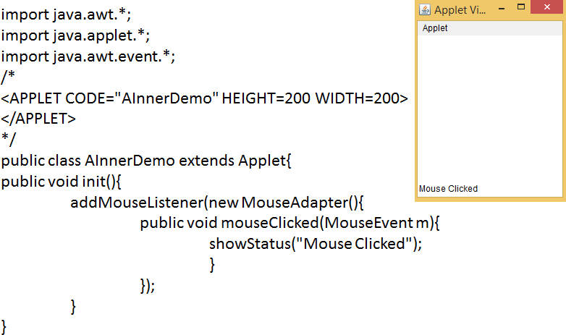
Event Handling in Java
Event Handling using Anonymous Inner Classes :

